Slide 1
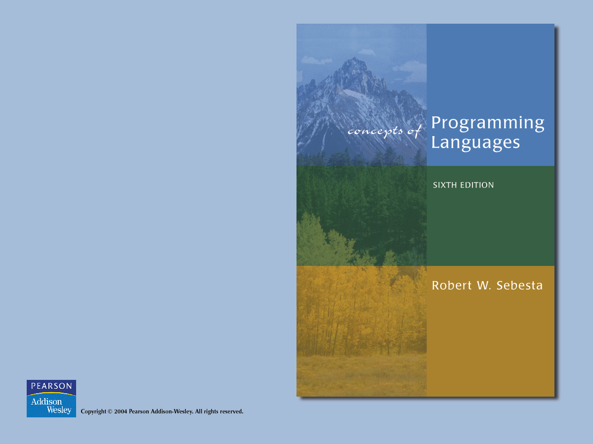
Chapter 8
Statement-Level
Control Structures

Slide 2

Chapter 8 Topics
Introduction
Selection Statements
Iterative Statements
Unconditional Branching
Guarded Commands
Conclusions

Slide 3
Introduction
Levels of Control Flow:
  1. Within expressions
  2. Among program units
  3. Among program statements

Slide 4
Introduction
Evolution:
  FORTRAN I control statements were based directly on IBM 704 hardware
  Much research and argument in the 1960s about the issue
  One important result: It was proven that all flowcharts can be coded with only two-way selection and pretest logical loops

Slide 5
Introduction
Def: A control structure is a control statement and the statements whose execution it controls
Overall Design Question:
  What control statements should a language have, beyond selection and pretest logical loops?

Slide 6
Selection Statements
A selection statement provides the means of choosing between two or more paths of execution
Two general categories:
  Two-way selectors
  Multiple-way selectors

Slide 7
Two-Way Selection Statements
Design Issues:
  1. What is the form and type of the control expression?
  2. How are the then and else clauses specified?
  3. How should the meaning of nested selectors be specified?

Slide 8
Two-Way Selection Statements
Examples
  FORTRAN IF: IF (boolean_expr) statement
  Problem: can select only a single statement; to select more, a GOTO must be used, as in the following example

Slide 9
Two-Way Selection Statements
FORTRAN example:
IF (.NOT. condition) GOTO 20
...
...
20 CONTINUE
Negative logic is bad for readability
This problem was solved in FORTRAN 77
Most later languages allow compounds for the selectable segment of their single-way selectors

Slide 10
Two-Way Selection Statements
Examples
  ALGOL 60 if:
if (boolean_expr)
then statement (the then clause)
else statement (the else clause)
  The statements could be single or compound

Slide 11
Two-Way Selection Statements
Nested Selectors
e.g. (Java) if ...
if ...
...
else ...
Which if gets the else?
Java's static semantics rule: else goes with the nearest if

Slide 12
Two-Way Selection Statements
ALGOL 60's solution - disallow direct nesting
if ... then if ... then
begin begin
if ... if ... then ...
then ... end
else ... else ...
end

Slide 13
Two-Way Selection Statements
FORTRAN 90 and Ada solution – closing special words
  e.g. (Ada)
if ... then if ... then
if ... then if ... then
... ...
else end if
... else
end if ...
end if end if
  Advantage: readability

Slide 14
Multiple-Way Selection Statements
Design Issues:
  1. What is the form and type of the control expression?
  2. How are the selectable segments specified?
  3. Is execution flow through the structure restricted to include just a single selectable segment?
  4. What is done about unrepresented expression values?

Slide 15
Multiple-Way Selection Statements
Early Multiple Selectors:
1. FORTRAN arithmetic IF (a three-way selector)
IF (arithmetic expression) N1, N2, N3
Bad aspects:
  Not encapsulated (selectable segments could be anywhere)
  Segments require GOTOs
2. FORTRAN computed GOTO and assigned GOTO

Slide 16
Multiple-Way Selection Statements
Modern Multiple Selectors
1. Pascal case (from Hoare's contribution to ALGOL W)
case expression of
constant_list_1 : statement_1;
...
constant_list_n : statement_n
end

Slide 17
Multiple-Way Selection Statements
Design choices:
  1. Expression is any ordinal type (int, boolean, char, enum)
  2. Segments can be single or compound
  3. Only one segment can be executed per execution of the construct
  4. In Wirth's Pascal, result of an unrepresented control expression value is undefined (In 1984 ISO Standard, it is a runtime error)
  Many dialects now have otherwise or else clause

Slide 18
Multiple-Way Selection Statements
2. The C, C++, and Java switch
switch (expression)
{
constant_expression_1 : statement_1;
...
constant_expression_n : statement_n;
[default: statement_n+1]
}

Slide 19
Multiple-Way Selection Statements
Design Choices: (for switch)
  1. Control expression can be only an integer type
  2. Selectable segments can be statement sequences, blocks, or compound statements
  3. Any number of segments can be executed in one execution of the construct (there is no implicit branch at the end of selectable segments)
    (a trade-off between reliability and flexibility--convenience)
    To avoid it, the programmer must supply a break statement for each segment
  4. default clause is for unrepresented values (if there is no default, the whole statement does nothing)

Slide 20
Multiple-Way Selection Statements
3. Ada's case is similar to Pascal's case, except:
  1. Constant lists can include:
  Subranges e.g., 10..15
  Boolean OR operators
  e.g., 1..5 | 7 | 15..20
  2. Lists of constants must be exhaustive
  Often accomplished with others clause
  This makes it more reliable

Slide 21
Multiple-Way Selection Statements
Multiple Selectors can appear as direct extensions to two-way selectors, using else-if clauses
  (ALGOL 68, FORTRAN 90, Ada)
  Ada:
  if ...
  then ...
  elsif ...
  then ...
  elsif ...
  then ...
  else ...
  end if

Slide 22
Multiple-Way Selection Statements
Ada’s multiple selectors:
  Far more readable than deeply nested if's
  Allows a Boolean gate on every selectable group

Slide 23
Iterative Statements
The repeated execution of a statement or compound statement is accomplished either by iteration or recursion
Here we look at iteration, because recursion is unit-level control
General design issues for iteration control statements:
  1. How is iteration controlled?
  2. Where is the control mechanism in the loop?

Slide 24
Iterative Statements
1. Counter-Controlled Loops
Design Issues:
  1. What are the type and scope of the loop variable?
  2. What is the value of the loop variable at loop termination?
  3. Should it be legal for the loop variable or loop parameters to be changed in the loop body, and if so, does the change affect loop control?
  4. Should the loop parameters be evaluated only once, or once for every iteration?

Slide 25
Iterative Statements
1. FORTRAN 90
Syntax: DO label var = start, finish [, stepsize]
Stepsize can be any value but zero
Parameters can be expressions
Design choices:
  1. Loop variable must be INTEGER
  2. Loop variable always has its last value
  3. The loop variable cannot be changed in the loop, but the parameters can; because they are evaluated only once, it does not affect loop control
  4. Loop parameters are evaluated only once

Slide 26
Iterative Statements
FORTRAN 90’s Other DO
  Syntax:
[name:] DO variable = initial, terminal [, stepsize]
…
END DO [name]
  Loop variable must be an INTEGER

Slide 27
Iterative Statements
2. ALGOL 60
Syntax: for var := <list_of_stuff> do statement where <list_of_stuff> can have:
  list of expressions
  expression step expression until expression
  expression while boolean_expression
for index := 1 step 2 until 50,
60, 70, 80,
index + 1 until 100 do
(index = 1, 3, 5, 7, ..., 49, 60, 70, 80,
81, 82, ..., 100)

Slide 28
Iterative Statements
ALGOL 60 Design choices:
  1. Control expression can be int or real; its scope is whatever it is declared to be
  2. Control variable has its last assigned value after loop termination
  3. The loop variable cannot be changed in the loop, but the parameters can, and when they are, it affects loop control
  4. Parameters are evaluated with every iteration, making it very complex and difficult to read

Slide 29
Iterative Statements
3. Pascal
Syntax:
for variable := initial (to | downto) final do statement
Design Choices:
  1. Loop variable must be an ordinal type of usual scope
  2. After normal termination, loop variable is undefined
  3. The loop variable cannot be changed in the loop; the loop parameters can be changed, but they are evaluated just once, so it does not affect loop control
  4. Just once

Slide 30
Iterative Statements
4. Ada
Syntax:
for var in [reverse] discrete_range loop ...
end loop

Slide 31
Iterative Statements
Ada Design choices:
  1. Type of the loop variable is that of the discrete range; its scope is the loop body (it is implicitly declared)
  2. The loop variable does not exist outside the loop
  3. The loop variable cannot be changed in the loop, but the discrete range can; it does not affect loop control
  4. The discrete range is evaluated just once

Slide 32
Iterative Statements
5. C
Syntax:
  for ([expr_1] ; [expr_2] ; [expr_3]) statement
  The expressions can be whole statements, or even statement sequences, with the statements separated by commas
  The value of a multiple-statement expression is the value of the last statement in the expression
  e.g.,
  for (i = 0, j = 10; j == i; i++) …
  If the second expression is absent, it is an infinite loop

Slide 33
Iterative Statements
C Design Choices:
  1. There is no explicit loop variable
  2. Irrelevant
  3. Everything can be changed in the loop
  4. The first expression is evaluated once, but the other two are evaluated with each iteration
This loop statement is the most flexible

Slide 34
Iterative Statements
6. C++
Differs from C in two ways:
  1. The control expression can also be Boolean
  2. The initial expression can include variable definitions (scope is from the definition to the end of the loop body)
7. Java
Differs from C++ in that the control expression must be Boolean

Slide 35
Iterative Statements
2. Logically-Controlled Loops
Design Issues:
  1. Pretest or posttest?
  2. Should this be a special case of the counting loop statement (or a separate statement)?

Slide 36
Iterative Statements
Language Examples:
  1. Pascal has separate pretest and posttest logical loop statements (while-do and repeat-until)
  2. C and C++ also have both, but the control expression for the posttest version is treated just like in the pretest case (while - do and do - while)
  3 Java is like C, except the control expression must be Boolean (and the body can only be entered at the beginning--Java has no goto

Slide 37
Iterative Statements
Language Examples (continued):
  4. Ada has a pretest version, but no posttest
  5. FORTRAN 77 and 90 have neither
  6. Perl has two pretest logical loops, while and until, but no posttest logical loop

Slide 38
Iterative Statements
3. User-Located Loop Control Mechanisms
Design issues:
  1. Should the conditional be part of the exit?
  2. Should control be transferable out of more than one loop?

Slide 39
Iterative Statements
Examples:
1. Ada - conditional or unconditional; for any loop; any number of levels
for ... loop LOOP1:
... while ... loop
exit when ... ...
... LOOP2:
end loop for ... loop
...
exit LOOP1 when ..
...
end loop LOOP2;
...
end loop LOOP1;

Slide 40
Iterative Statements
2. C , C++, and Java - break
Unconditional; for any loop or switch; one level only (except Java’s can have a label)
There is also a continue statement for loops; it skips the remainder of this iteration, but does not exit the loop

Slide 41
Iterative Statements
3. FORTRAN 90 - EXIT
Unconditional; for any loop, any number of levels
FORTRAN 90 also has CYCLE, which has the same semantics as C's continue

Slide 42
Iterative Statements
Iteration Based on Data Structures
  Concept: use order and number of elements of some data structure to control iteration
  Control mechanism is a call to a function that returns the next element in some chosen order, if there is one; else exit loop
  C's for can be used to build a user-defined iterator
  e.g. for (p=hdr; p; p=next(p))
  { ... }

Slide 43
Iterative Statements
Perl has a built-in iterator for arrays and hashes
e.g.,
foreach $name (@names)
{ print $name }

Slide 44
Unconditional Branching
Problem: readability
Some languages do not have them: e.g., Java
Loop exit statements are restricted and somewhat camouflaged goto’s

Slide 45
Unconditional Branching
Label forms:
1. Unsigned int constants: Pascal (with colon)
FORTRAN (no colon)
2. Identifiers with colons: ALGOL 60, C
3. Identifiers in << ... >>: Ada
4. Variables as labels: PL/I
  Can be assigned values and passed as parameters
  Highly flexible, but make programs impossible to read and difficult to implement

Slide 46
Guarded Commands
Dijkstra, 1975
Purpose: to support a new programming methodology (verification during program development)

Slide 47
Guarded Commands
1. Selection: if <boolean> -> <statement>
[]<boolean> -> <statement>
...
[] <boolean> -> <statement>
fi
Semantics: when this construct is reached,
  Evaluate all boolean expressions
  If more than one are true, choose one nondeterministically
  If none are true, it is a runtime error

Slide 48
Guarded Commands
Idea: if the order of evaluation is not important, the program should not specify one

Slide 49
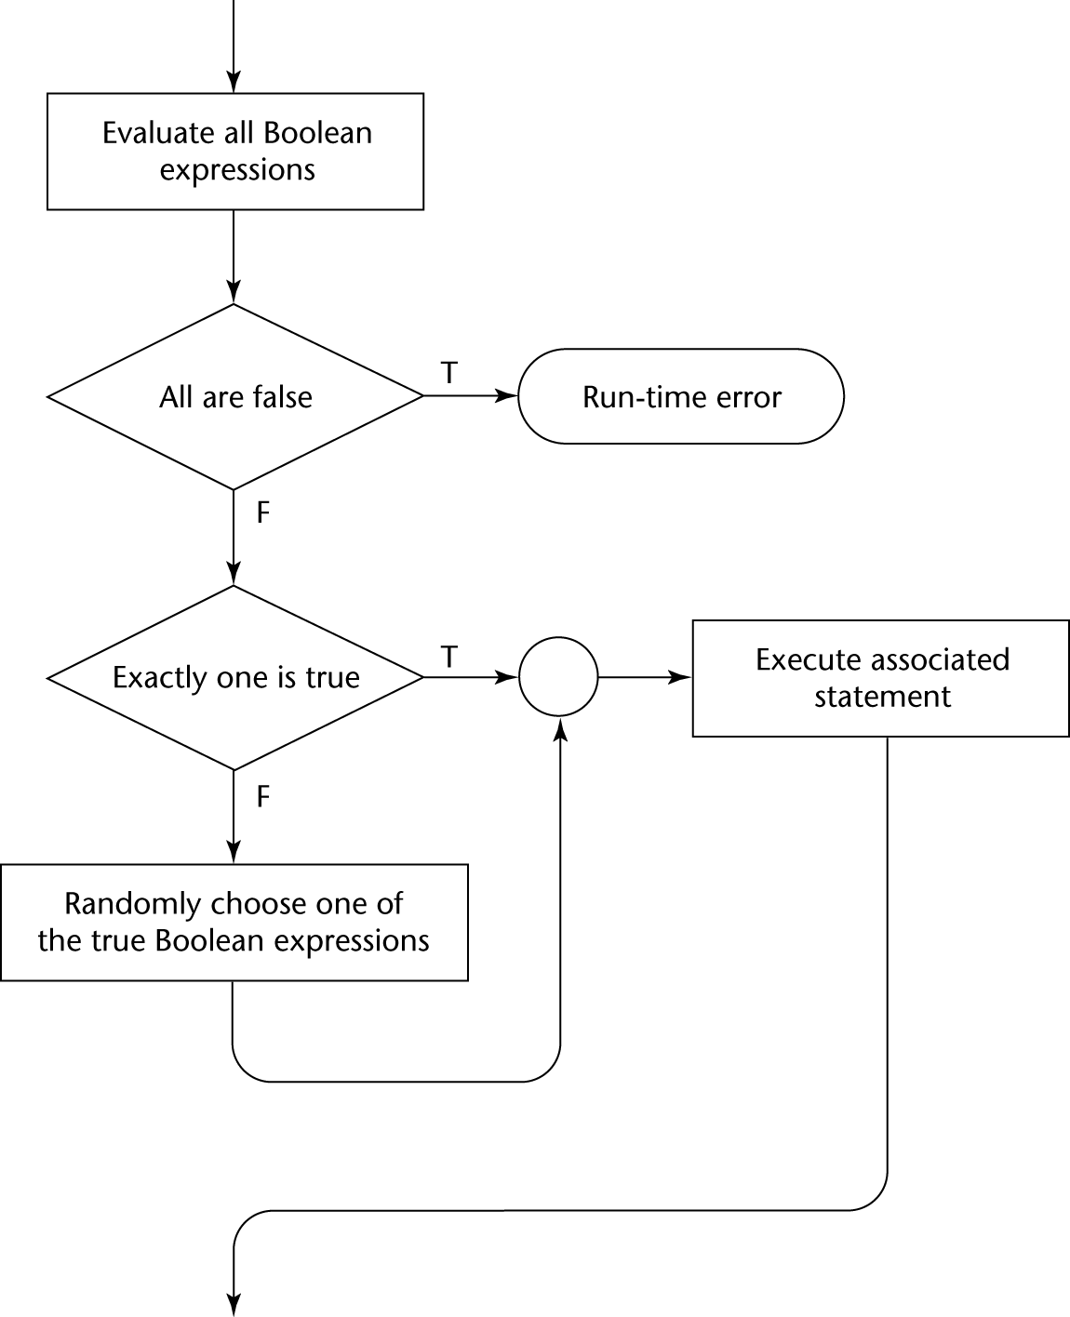
Guarded Commands

Slide 50
Guarded Commands
2. Loops do <boolean> -> <statement>
[] <boolean> -> <statement>
...
[] <boolean> -> <statement>
od

Slide 51
Guarded Commands
Semantics: For each iteration:
  Evaluate all boolean expressions
  If more than one are true, choose one nondeterministically; then start loop again
  If none are true, exit loop

Slide 52
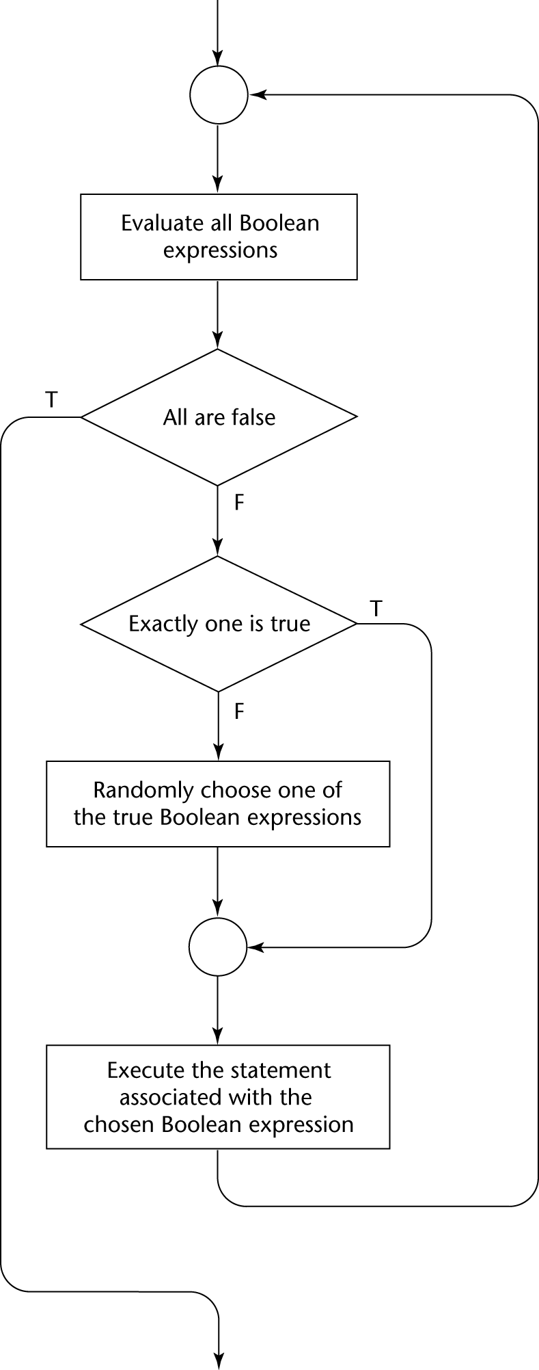
Guarded Commands

Slide 53
Guarded Commands
Connection between control statements and program verification is intimate
Verification is impossible with gotos
Verification is possible with only selection and logical pretest loops
Verification is relatively simple with only guarded commands

Slide 54
Conclusion
Choice of control statements beyond selection and logical pretest loops is a trade-off between language size and writability

